Slide 1
Database Connectivity with Java
Prativa Nyaupane

Slide 2
Recap
JDBC Driver Types and Configuration
Managing Connections and Statements
Result Sets and Exception Handling

Slide 3
Outline
JDBC Architecture
JDBC Driver Types and Configuration
Managing Connections and Statements
Result Sets and Exception Handling
DDL and DML Operations
SQL Injection and Prepared Statements
Row Sets and Transactions
SQL Escapes

Slide 4
DDL and DML Operations
DDL (Data Definition Language) Operations:
It is a programming language for creating and modifying database objects such as tables, indices and users. DDL deals with the structure of the database.
Operations include creating, altering, and deleting database objects like tables, indexes, and views.
Examples: CREATE TABLE, ALTER TABLE, DROP TABLE.
DROP TABLE employees;
DML (Data Manipulation Language) Operations:
It is a programming language for adding(inserting), deleting and modifying data in a database. DML deals with the data stored in the database.
Operations include inserting, updating, and deleting data in tables.
Examples: INSERT INTO, UPDATE, DELETE FROM.
INSERT INTO employees (first_name, last_name, fname) VALUES ('John', 'Capita', 'xcapit00');

Slide 5
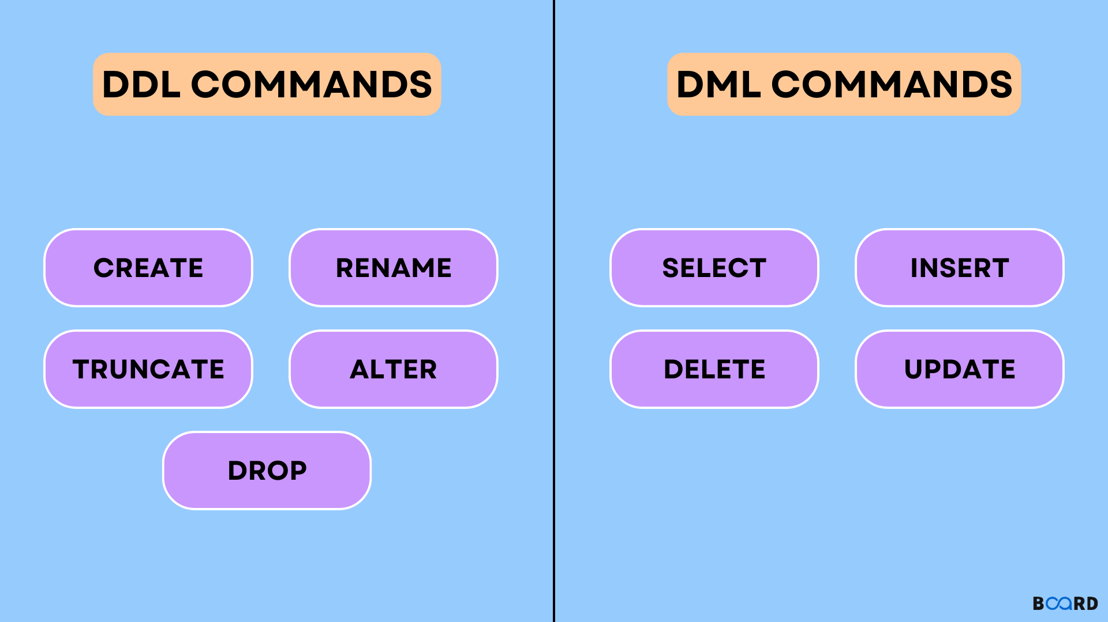

Slide 6
SQL Injection
SQL Injection is a code injection technique where attackers insert malicious SQL statements into input fields or queries.
This can lead to unauthorized access to databases, extraction of sensitive information, or even the deletion or manipulation of data.
SQL Injection can result in unauthorized access, data exfiltration, data manipulation, or even complete compromise of a database.
Three types of SQL Injection are:
Classic SQL Injection
Blind SQL injection
Time-base Blind SQL Injection

Slide 7
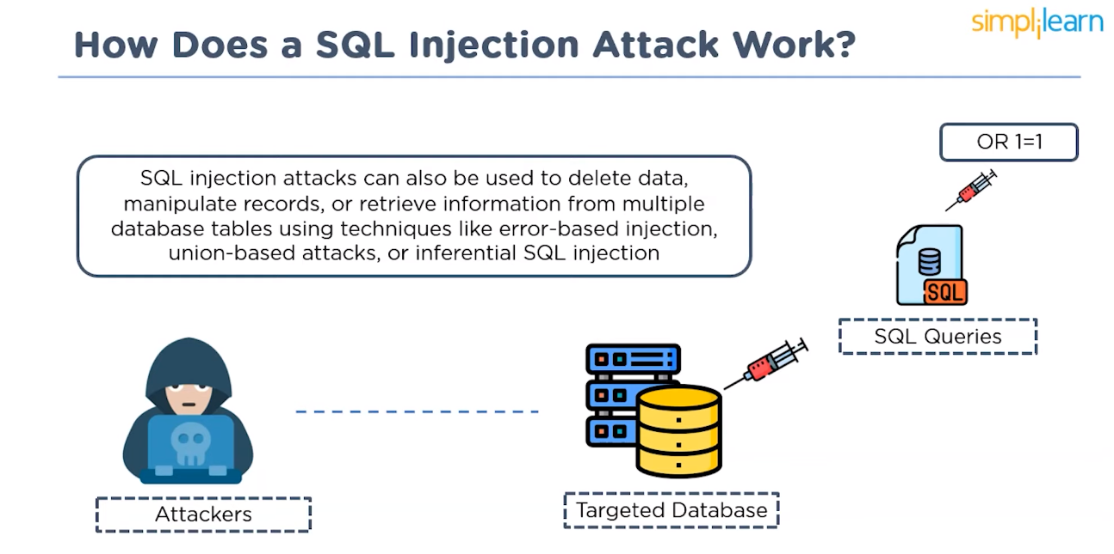

Slide 8
Classic SQL Injection
Attackers inject malicious SQL code through user inputs like forms or URL parameters. The injected SQL code is typically used to extract data from the database or manipulate its behavior. The attacker can often see the results of their injected SQL code directly in the application's response, such as retrieving usernames, passwords, or other sensitive information.
Example: Imagine an app that returns all your information after logging in. That query may look like the following:
SELECT * FROM users WHERE username = 'USER_INPUT';
If an attacker were to submit a malicious input, the query could change to the following:
SELECT * FROM users WHERE username = '' OR '1'='1';
This query will return all users as '1'='1' will always return true.

Slide 9
Blind SQL Injection:
Attackers infer the success or failure of injected queries without directly retrieving results.
Example: Modifying a query to cause a delay, and then observing if the page takes longer to load. Suppose we have a simple table called users with columns username and password, and we want to check if a user with a given username and password exists. We can use the following query:
SELECT * FROM users WHERE username = 'username' AND password = 'password'
To perform a blind SQL injection, an attacker might exploit this query to bypass authentication without knowing valid credentials. They can inject a condition that is always true. For instance:
SELECT * FROM users WHERE username = 'admin' AND '1'='1' -- ' AND password = 'anything'
In this injection, '1'='1' -- ' is always true due to the equality condition. The -- at the end comments out the rest of the original query to avoid syntax errors. The attacker doesn't need to know the actual password because the injected condition always evaluates to true, granting access to the account associated with the username 'admin'.

Slide 10
Time-Based Blind SQL Injection
It is a type of blind/inferential injection attack.
Delays the server's response to infer the success of a query.
In a time-based attack, an attacker sends an SQL command to the server with code to force a delay in the execution of the queries.
The response time indicated whether the result of the query is true or false.
Example: Adding a sleep function to a query and observing if the delay occurs.
/* Resulting query (with malicious SLEEP injected). */
SELECT * FROM table WHERE id=1-SLEEP(15)
When an attacker tries to use these functions in the query and if he is successful in slowing the response, it proves SQL injection is possible and the server is using MySQL as a database.

Slide 11
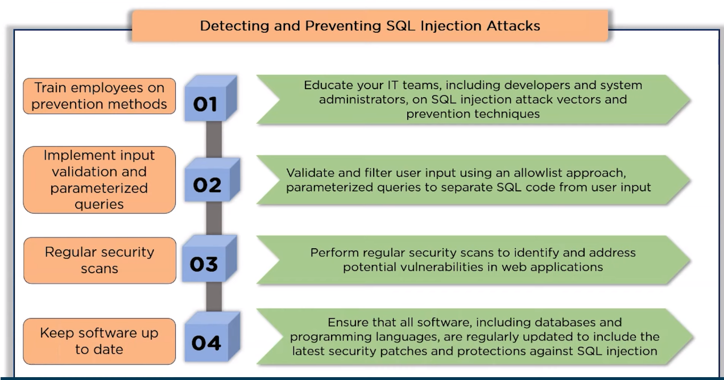

Slide 12
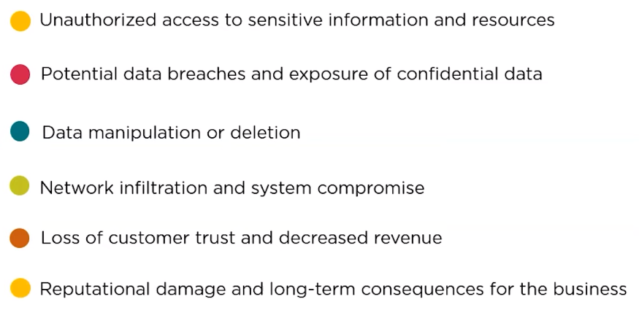
Impact of SQL Injection Attacks

Slide 13
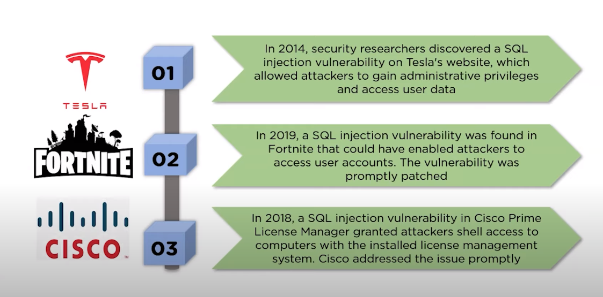
Real-Life SQL Injection Examples

Slide 14
Prepared Statements
In DBMS, a prepared statement, parameterized statement or parameterized query is a feature where the database pre-compiles SQL code and stores the results, separating it from data.
It provides efficiency, as they can be used repeatedly without re-compiling.
It enhances security by reducing or eliminating SQL injection attacks.
Parameterized queries created and compiled once, then reused with different parameters.

Slide 15
Using Prepared Statement
A Prepared Statement is a feature of JDBC that allows the creation of parameterized SQL statements.
It enables the application to execute the same SQL statement repeatedly with different parameter values, improving performance and security.
Prepared Statements are precompiled and cached by the database, reducing the need for repetitive parsing and optimizing query execution.

Slide 16
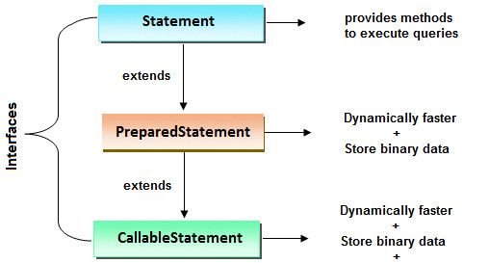

Slide 17
Example of Prepared Statement
Creating Database Connection
Connection con = DriverManager.getConnection("----", "system", "oracle");
PreparedStatement stmt =
con.prepareStatement("insert into Emp values(?,?)");
stmt.setInt(1,101);//1 specifies the first parameter in the query
stmt.setString(2,"Ratan");
int i=stmt.executeUpdate();
System.out.println(i+" records inserted");
Prepare statement to replace ‘?’ with required information
Replacing ‘?’ with required value in the query.
Execute the prepared statement

Slide 18
Methods of PreparedStatement interface
Method | Description
public void setInt(int paramIndex, int value) | sets the integer value to the given parameter index.
public void setString(int paramIndex, String value) | sets the String value to the given parameter index.
public void setFloat(int paramIndex, float value) | sets the float value to the given parameter index.
public void setDouble(int paramIndex, double value) | sets the double value to the given parameter index.
public int executeUpdate() | executes the query. It is used for create, drop, insert, update, delete etc.
public ResultSet executeQuery() | executes the select query. It returns an instance of ResultSet.

Slide 19
Row Sets and Transactions
Row Sets:
A disconnected set of rows from a ResultSet.
Allows for more flexibility in data manipulation, especially in disconnected or distributed environments.
Types include CachedRowSet, WebRowSet, and FilteredRowSet.
Transactions:
A sequence of one or more SQL statements executed as a single unit of work.
Ensures data consistency by either committing all changes or rolling back to the initial state.
JDBC supports transaction management using commit and rollback operations.

Slide 20
SQL Escapes
Mechanism for representing special characters or reserved keywords in SQL queries.
Helps prevent syntax errors or conflicts in SQL statements.
Examples include using double quotes for identifiers or escaping special characters like apostrophes.
SELECT * FROM my_table WHERE column_name LIKE 'O''Connor' ;
We're searching for records where the value in column_name is "O'Connor".
The single quote character within the string "O'Connor" is escaped by doubling it (''). This is the standard way to escape single quotes in SQL strings.

Slide 21
Thank You

